Slide 1



AI-INTEGRATED HOME AND COMMUNITY PROTECTION SYSTEM
SUPPORT SDG 11
Project Coordinator: Arun M
Thanush K - 211191101159
Project Guide: Ms.A.MAHESWARI
Santhosh R - 211191101131

Slide 2

ABSTRACT
Safety in the community is still a major issue in smart city planning, with growing issues of theft, fire risks, gas leaks, and delayed emergency responses. A survey of residential communities in Chennai found that 65.2% of the respondents had theft incidents, mostly in community areas (83.5%), and 55.6% had gas leaks, with 72.8% showing high concern for safety threats. To counteract the limitations, we developed an AI-Based Home and Community Safety System based on IoT-based sensors, real-time communication protocols, and mobile-based monitoring interface. The system consists of flame and gas sensors, OLED display, theft, medical, and false alarm push buttons, and buzzers and LED indicators for notification. A wireless communication framework based on MQTT protocol supports real-time emergency notification among the households to provide immediate response and risk reduction. There is also an IoT dashboard on mobile provided for real-time remote monitoring and controlling of the system, which facilitates ease of access and user interaction. The survey also reflected high community interest in AI-based safety systems with 67.4% considering them to be highly effective and 79.7% willing to trial the system. Prototype testing proved low-latency notifications, efficient hazard detection, and enhanced emergency response systems. The suggested system is in compliance with Sustainable Development Goals (SDG 11 & SDG 9) by increasing the resilience of cities and encouraging smart safety infrastructure.
Index Terms - Community safety, AI, IoT, MQTT, Smart cities, Emergency response, Sustainable Development Goals, Urban resilience, IoT dashboard, Remote monitoring
1159- Thanush
1131- Santhosh
AI-INTEGRATED HOME AND COMMUNITY PROTECTION SYSTEM SUPPORT SDG 11
2/21

Slide 3
INTRODUCTION
With the cities continuing to expand, communities' safety is now a city's number-one priority worldwide. With projections indicating that 66% of the world's population will reside in cities by the year 2050, cities are increasingly faced with the imperative of finding effective, scalable, and innovative solutions to safety issues. Traditional security systems are usually ineffective in the event of an emergency situation such as theft, fire hazards, gas leaks, and medical issues. Conventional methods like CCTV cameras, security personnel, and human monitoring systems are normally hindered by delayed response, non-real-time communication, and inefficiencies in emergency handling. Urban dwellers consequently often have to count on neighbors or security officers to notice and respond to events, adding to emergency response delays.
1159- Thanush
1131- Santhosh
AI-INTEGRATED HOME AND COMMUNITY PROTECTION SYSTEM SUPPORT SDG 11
3/21

Slide 4
LITERATURE SURVEY
Table. No.1
S.NO | AUTHORS | METHOD USED | METHOD DESCRIPTION | YEAR
1 | Abubaker Sherif [Et.,al] | Long Range (LoRa) wireless communication, panic button, embedded sensors, mobile and web applications | Development of a LoRa-driven home security system for a retirement township, with manual and automatic alerts and security management features | 2019
2 | Md Eshrat E. Alahi [Et.,al] | IoT-enabled technologies, Artificial Intelligence (AI), 5G networks, communication technologies | Review of IoT and AI integration for smart cities, covering wireless communication technologies, AI algorithms, and their potential impact on urban environments | 2023
3 | Md Eshrat E. Alahi [Et.,al] | Internet of Things (IoT), wireless communications, networking technologies | Introduction of the smart community concept, including secure networking among smart homes and applications like Neighborhood Watch and Pervasive Healthcare. | 2021
1159- Thanush
1131- Santhosh
AI-INTEGRATED HOME AND COMMUNITY PROTECTION SYSTEM SUPPORT SDG 11
4/21

Slide 5
4 | Rui Yu, Minyuan Zhang[Et.,al] | IoT security analysis, smart home security, malware detection, router-based system | Smart home security system for detecting and defending against contactless attacks with minimal network impact; future plans include machine learning integration for enhanced anomaly detection. | 2021
5 | Vijaya Bhasker Reddy[Et.,al] | AI algorithms, Arduino controller, electronic sensors | Discusses integrating AI with IoT for home automation using sensors connected to an Arduino controller. The system automates appliances like fans, doors, and water pumps based on environmental data. | 2024
6 | Mageshkumar Naarayanasamy Varadarajan [Et.,al] | AI algorithms, IoT sensors, data analysis | Explores integrating AI with IoT for smart home automation, focusing on AI's role in analyzing IoT sensor data to automate tasks, improve energy management, and enhance security, while addressing challenges like privacy and interoperability. | 2024
7 | Jinsoo Han[Et.,al] | Home-to-home (H2H) communication, wireless communication, centralized and distributed architectures | The paper compares centralized and distributed H2H communication architectures for smart communities, using clustering to reduce traffic and improve reliability. | 2017
1159- Thanush
1131- Santhosh
AI-INTEGRATED HOME AND COMMUNITY PROTECTION SYSTEM SUPPORT SDG 11
5/21

Slide 6
PROBLEM STATEMENT
High Incident Rates in Chennai: Survey shows 65.2% thefts, 55.6% gas leaks, and concerns over fire and medical emergencies.
Fragmented Safety Solutions: Current systems rely on manual alerts and human intervention, leading to delays.
Inefficient Communication: Lack of integrated networks for real-time alerts to residents and authorities.
Limited Use of AI & Wireless Tech: Existing measures lack advanced AI-driven, automated responses.
Need for Sustainable Solutions: Traditional methods do not utilize solar power or sustainable, smart technologies.
1159- Thanush
1131- Santhosh
AI-INTEGRATED HOME AND COMMUNITY PROTECTION SYSTEM SUPPORT SDG 11
6/21

Slide 7
PROPOSED SYSTEM
AI-Integrated Safety Devices: Utilizes wireless, AI-enabled devices with voice and button-activated commands for rapid emergency response.
Comprehensive Sensor Network: Equipped with gas, fire, air quality, and environmental sensors for real-time threat detection.
Wireless Communication Module: Sends instant alerts to neighbors, authorities, and a centralized server room within a 1 km radius.
Solar-Powered Operation: Solar-powered LED lights and backup systems ensure sustainability and uninterrupted functionality.
Community Safety Platform: Centralized server system for data monitoring, storage, and analysis to improve community-wide safety measures.
1159- Thanush
1131- Santhosh
AI-INTEGRATED HOME AND COMMUNITY PROTECTION SYSTEM SUPPORT SDG 11
7/21

Slide 8
HARDWARE & SOFTWARE REQUIREMENTS
HARDWARE REQUIREMENTS:
Microcontroller (NodeMCU): Central unit to manage sensors, buttons, and communication.
Sensors: Includes MQ-135 for air quality, flame sensor for fire, and DHT22 for temperature & humidity monitoring.
Voice Recognition Module & Push Buttons: Enables voice and manual emergency triggers.
Solar-Powered LED & Mini Speaker: Provides visual and audible emergency alerts.
Wireless Communication Module: Facilitates real-time alerts and data transmission.
Power Supply & Protective Enclosure: Solar-powered with backup and secure casing for all components.
SOFTWARE REQUIREMENTS:
Python/C++ Programming: For microcontroller coding and device integration.
IoT Communication Protocols: Uses MQTT/HTTP for seamless data transmission.
Server Room Setup: For centralized data collection, monitoring, and alert management.
Database Management (MySQL): Stores incident data, device logs, and user information.
Device Interface: For user interaction, alerts, and system configuration.
1159- Thanush
1131- Santhosh
AI-INTEGRATED HOME AND COMMUNITY PROTECTION SYSTEM SUPPORT SDG 11
8/21

Slide 9
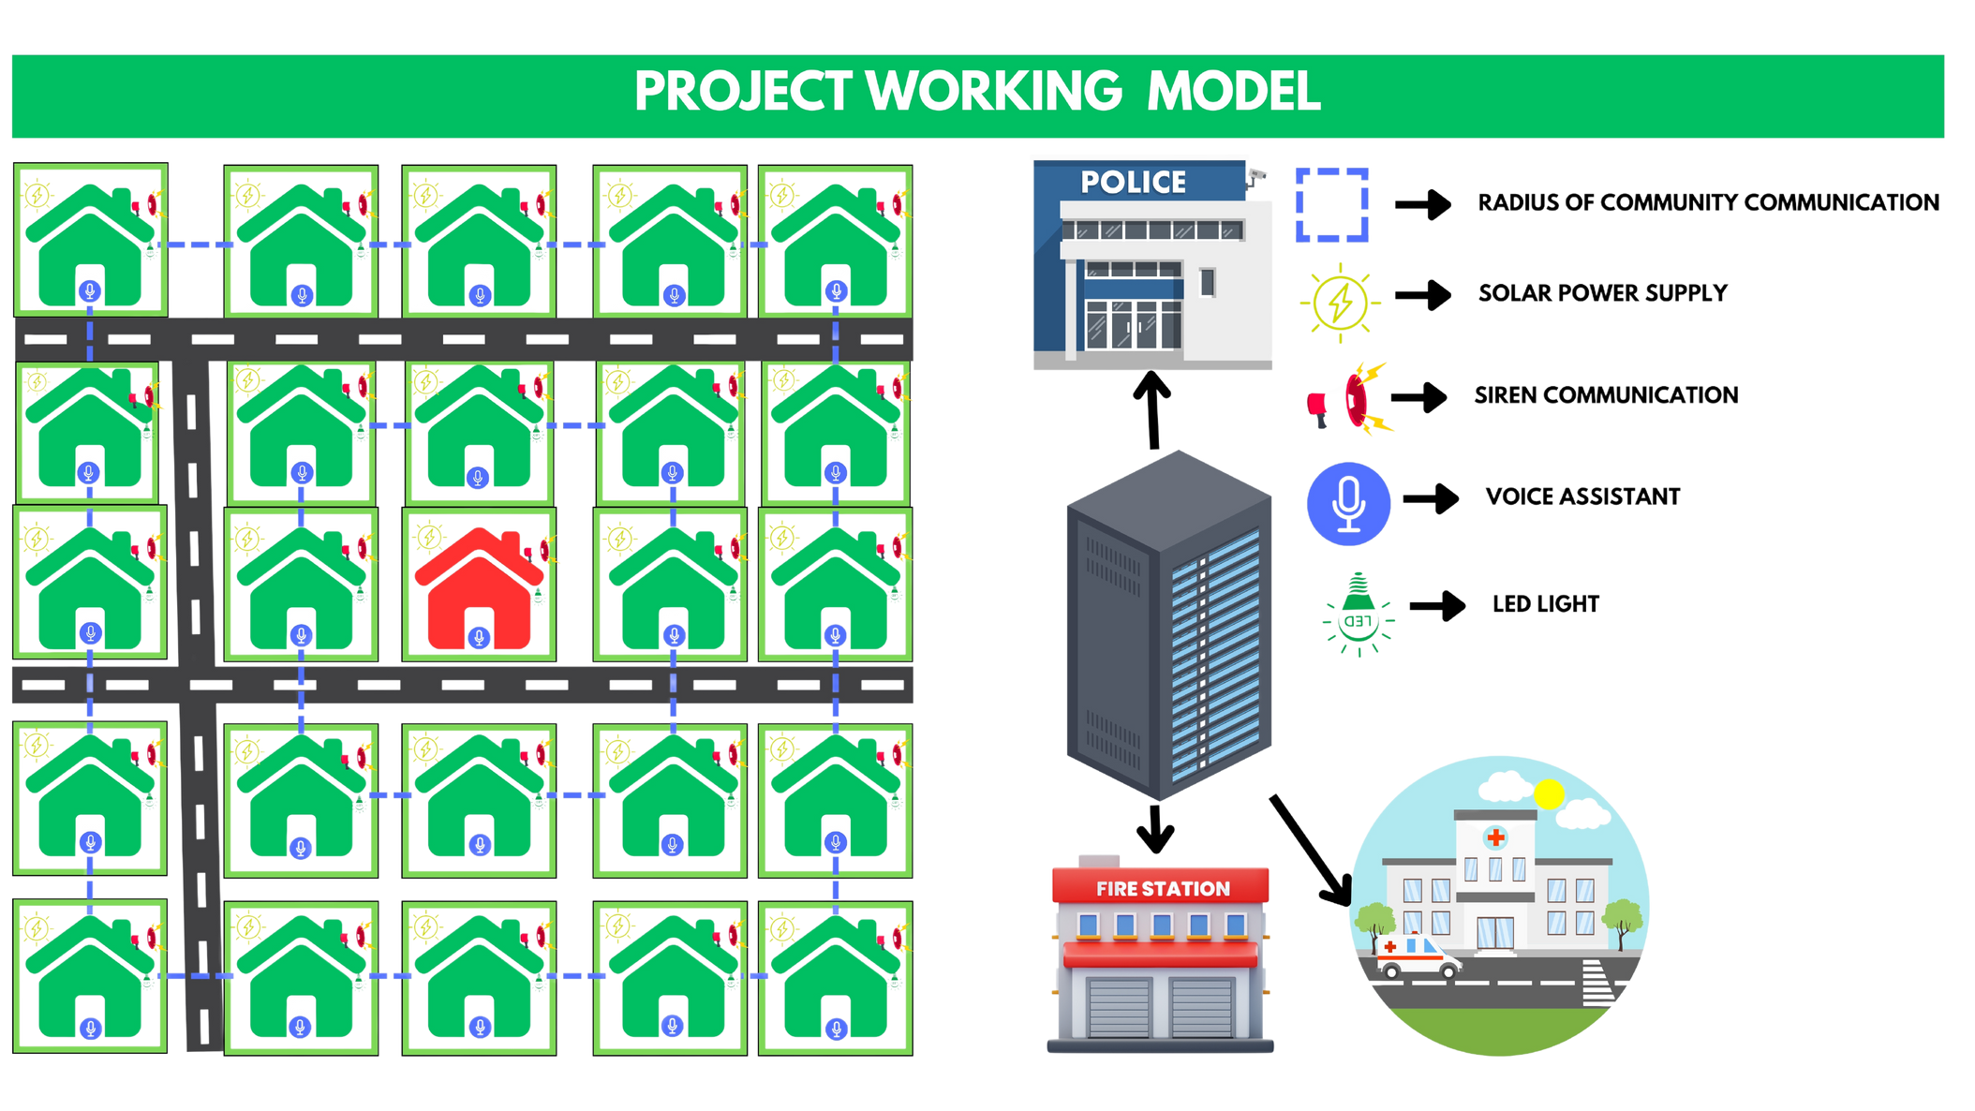
ARCHITECTURE DIAGRAM
Fig. No.1. Architectural Diagram of community
1159- Thanush
1131- Santhosh
AI-INTEGRATED HOME AND COMMUNITY PROTECTION SYSTEM SUPPORT SDG 11
9/21

Slide 10
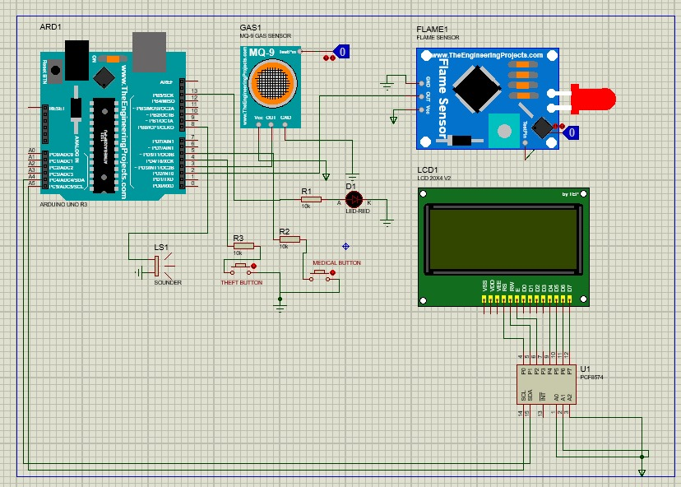
PROTOTYPE CIRCUIT IMAGE
1159- Thanush
1131- Santhosh
AI-INTEGRATED HOME AND COMMUNITY PROTECTION SYSTEM SUPPORT SDG 11
13/21

Slide 11
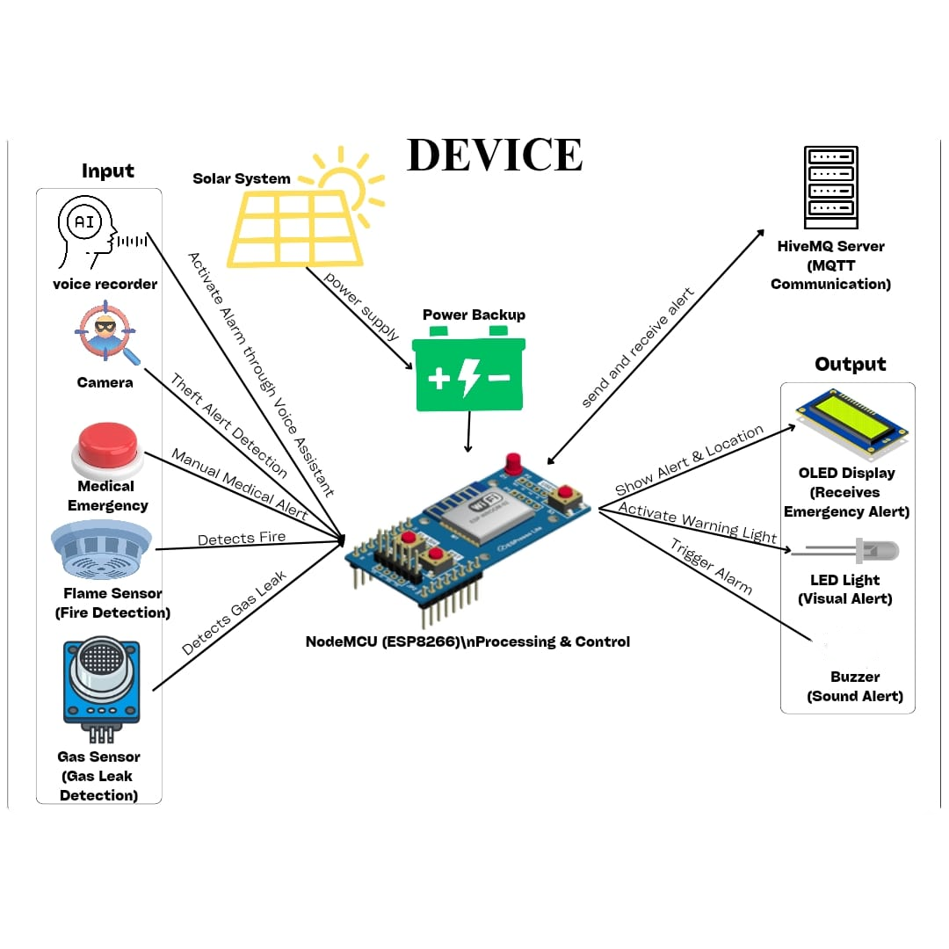
GENERAL ARCHITECTURE DIAGRAM
1159- Thanush
1131- Santhosh
AI-INTEGRATED HOME AND COMMUNITY PROTECTION SYSTEM SUPPORT SDG 11
10/21

Slide 12
OVERVIEW OF PROJECT
AI-Integrated Safety System:
A smart, IoT-based protection system utilizing microcontrollers to enhance community safety. Supports both voice and button commands for emergency detection and response.
Real-Time Emergency Alerts:
Detects incidents like theft, fire, medical emergencies, and harmful gases. Sends instant notifications to neighbors, authorities, and a centralized server room for coordinated action.
Sustainable Design:
Equipped with solar-powered components to ensure uninterrupted operation, promoting energy efficiency and aligning with sustainable urban living.
Survey Insights:
Survey across Chennai revealed significant safety concerns, with high occurrences of theft (65.2%), gas leaks (55.6%), and fire hazards. The system addresses these critical community safety gaps.
Scalable & Community-Focused:
Designed for deployment in residential areas, aiming to create a safer, more resilient smart city environment through AI and IoT integration.
1159- Thanush
1131- Santhosh
AI-INTEGRATED HOME AND COMMUNITY PROTECTION SYSTEM SUPPORT SDG 11
11/21

Slide 13
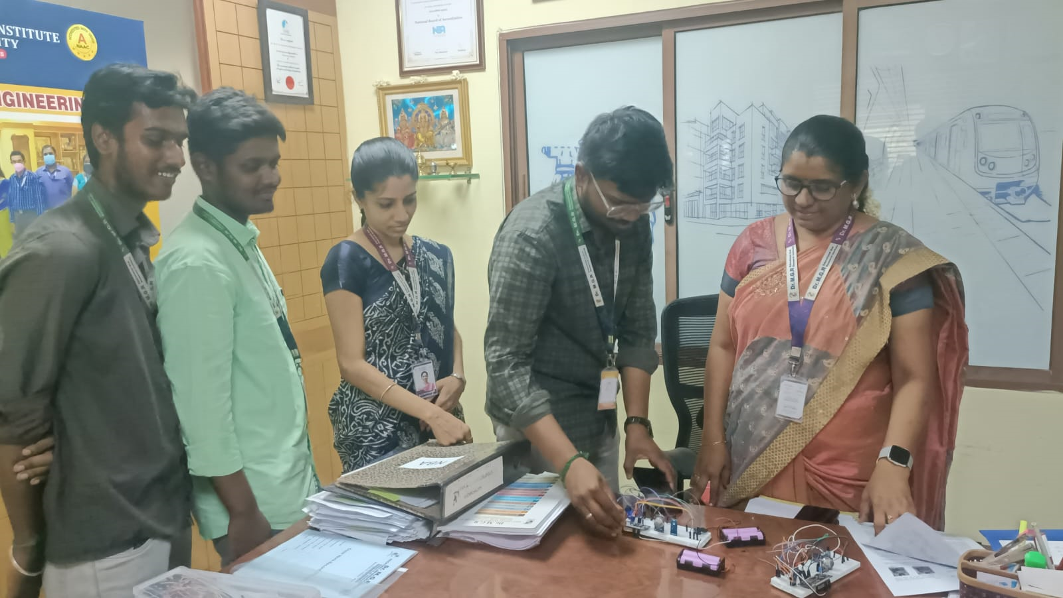
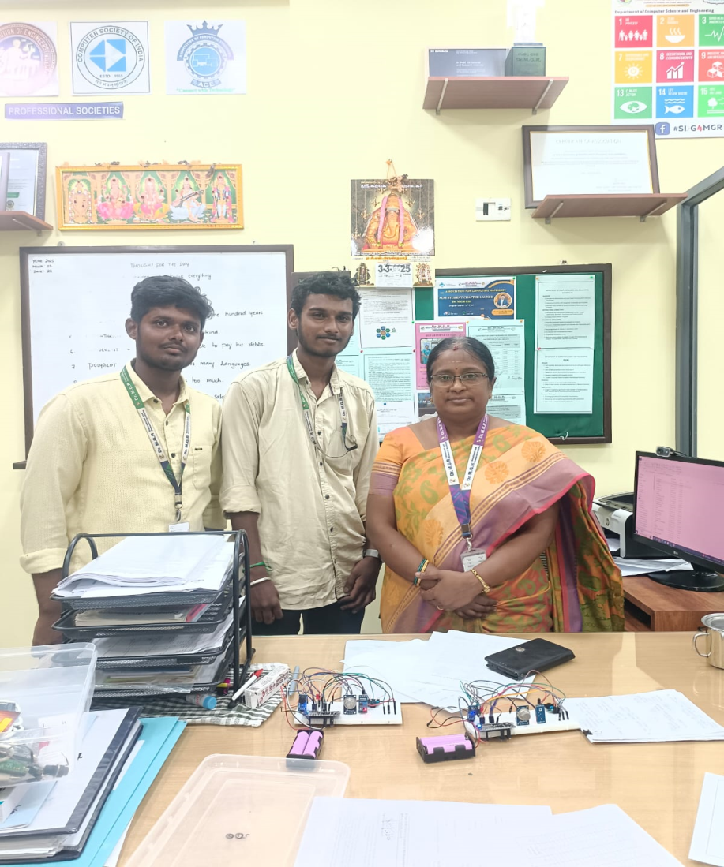
PROTOTYPE PRESENTION WITH HOD’S (CSE & CIVIL)
1159- Thanush
1131- Santhosh
AI-INTEGRATED HOME AND COMMUNITY PROTECTION SYSTEM SUPPORT SDG 11
12/21

Slide 14
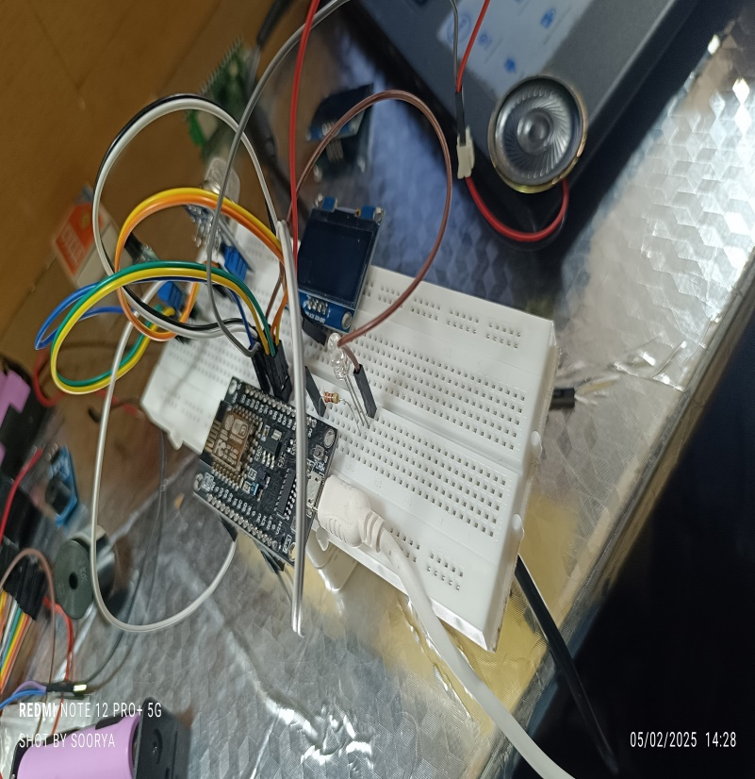
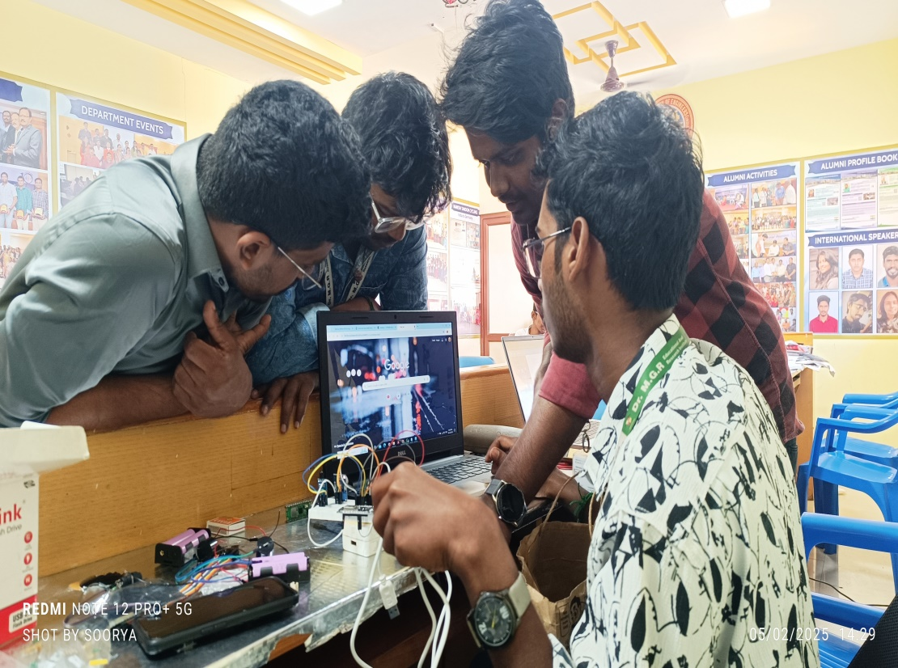
TEAM WORK
1159- Thanush
1131- Santhosh
AI-INTEGRATED HOME AND COMMUNITY PROTECTION SYSTEM SUPPORT SDG 11
14/21

Slide 15
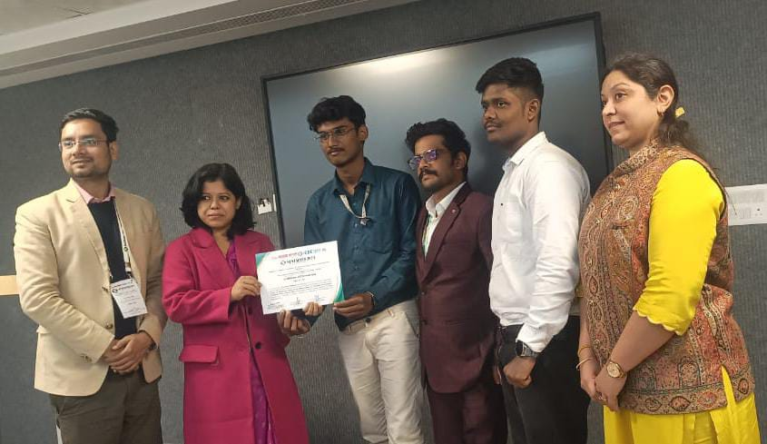
Conference Presentation
1159- Thanush
1131- Santhosh
AI-INTEGRATED HOME AND COMMUNITY PROTECTION SYSTEM SUPPORT SDG 11
14/21

Slide 16
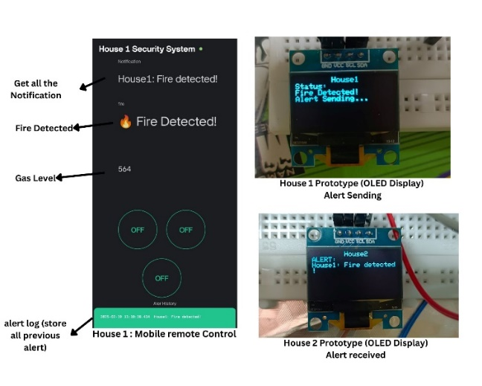
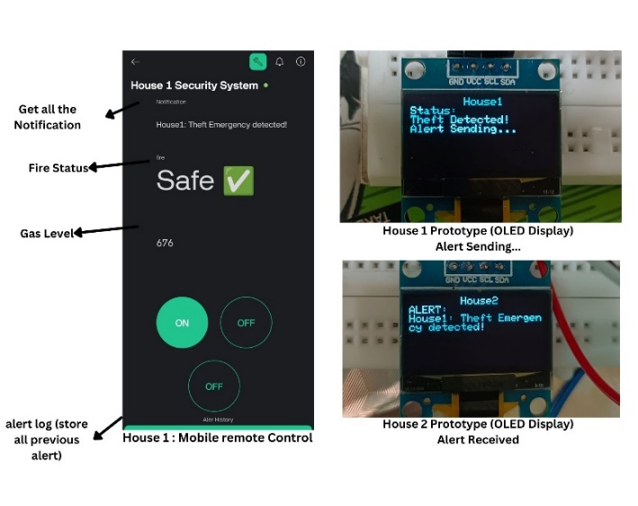
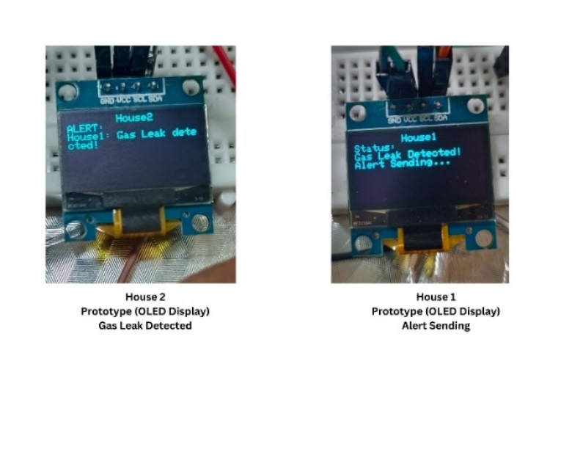
Result & Case Studys
Fire Detection Communication Between House 1 and House 2
Figure 5: Theft Detection and Emergency Communication Between House 1 and House 2
Gas Leak Detection Communication Between House 1 and House 2
1159- Thanush
1131- Santhosh
AI-INTEGRATED HOME AND COMMUNITY PROTECTION SYSTEM SUPPORT SDG 11
14/21

Slide 17
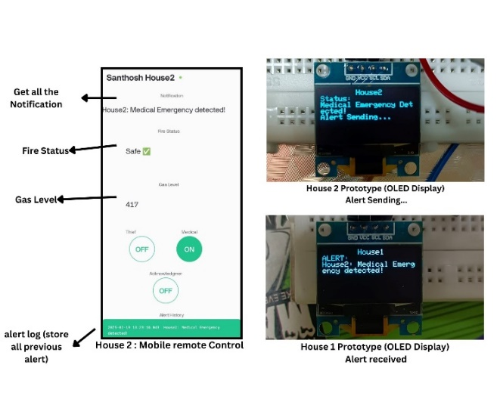
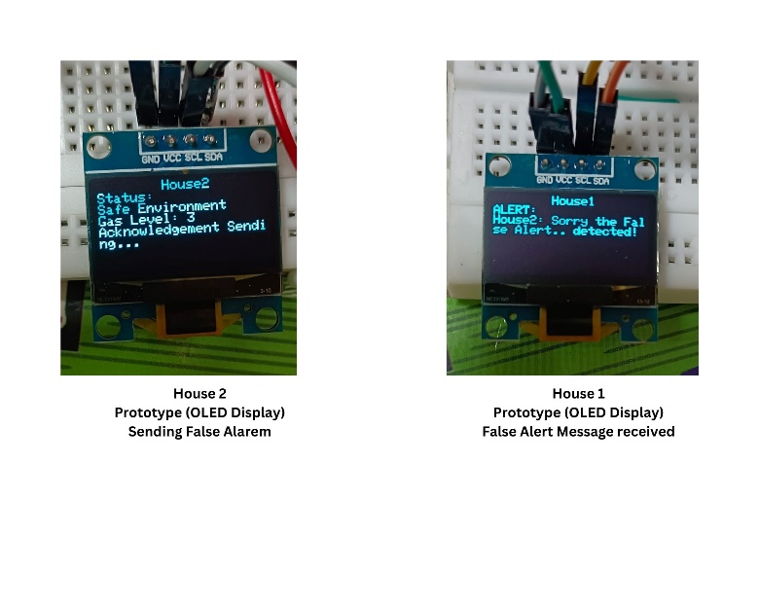
Figure 7: False Alarm Detection and Acknowledgment System
Figure 6: Medical Emergency Detection and Response Between House 1 and House 2
1159- Thanush
1131- Santhosh
AI-INTEGRATED HOME AND COMMUNITY PROTECTION SYSTEM SUPPORT SDG 11
14/21

Slide 18
Conclusion
The AI-Based Home and Community Safety System ensures safety in real-time by the utilization of emergency detection, IoT communication, and smart alerting features. The system based on MQTT message communication has enabled timely forwarding of notifications regarding theft, health issues, leakage of gas, and fire incidents to the community. The system is complemented by a mobile and web app interface, making it even more user-friendly for prompt response and monitoring. The introduction of an Acknowledgment Button has minimized false alarms, thus making it even more reliable and response effective.
1159- Thanush
1131- Santhosh
AI-INTEGRATED HOME AND COMMUNITY PROTECTION SYSTEM SUPPORT SDG 11
21/21

